Slide 1
International Conference of green Agro Industry: Investment for Our Future, Yogyakarta Indonesia, November 11-14, 2013
SWOT ANALYSIS FOR INTEGRATED ECO- TOURISM DEVELOPMENT IN STRENGTHENING NATIONAL RESILENCE
(CASE STUDY IN GAJAHWONG RIVER YOGYAKARTA, INDONESIA)
ISTIANA RAHATMAWATI
rahatmawati@yahoo.com
Management Department, Economic Faculty,
UPN “Veteran” Yogyakarta, Indonesia

Slide 2
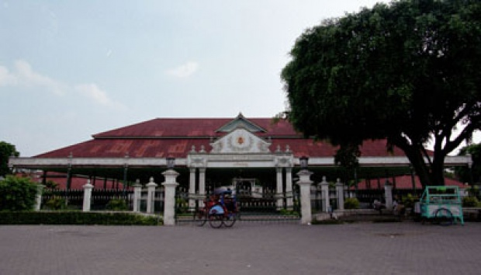
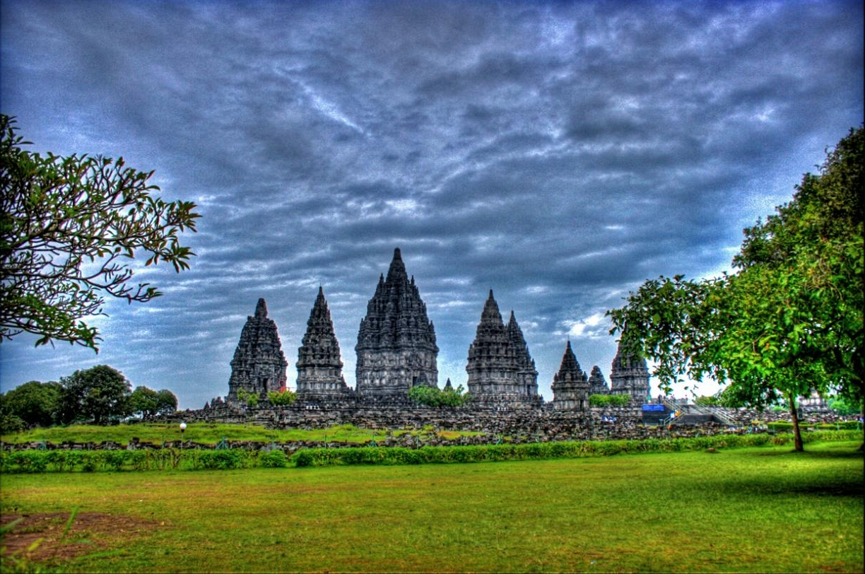
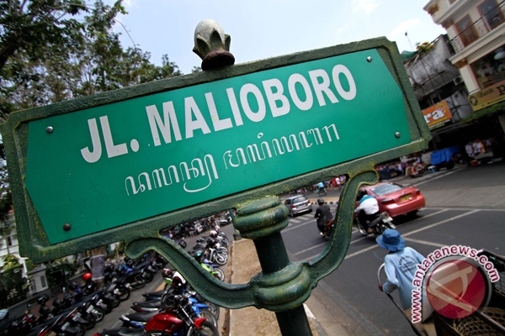
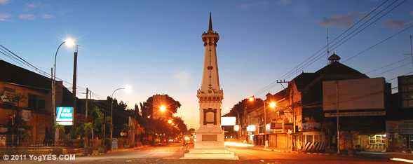
INTRODUCTION
The area of study is along Gajah Wong riverside area, located in Yogyakarta city
Yogyakarta is famous as tourist city
- rank no 9 for number of visitors (2.460.967 visitors in the year 2010)
- rank no 5 for the most favorite tourist destination city
(Minister of Tourism, 2010)
Yogyakarta have three rivers that flows from the north to the south separates the city.
namely :
Gajah Wong in the eastern Yogyakarta
Code in the middle of Yogyakarta city
Winongo in the western Yogyakarta

Slide 3
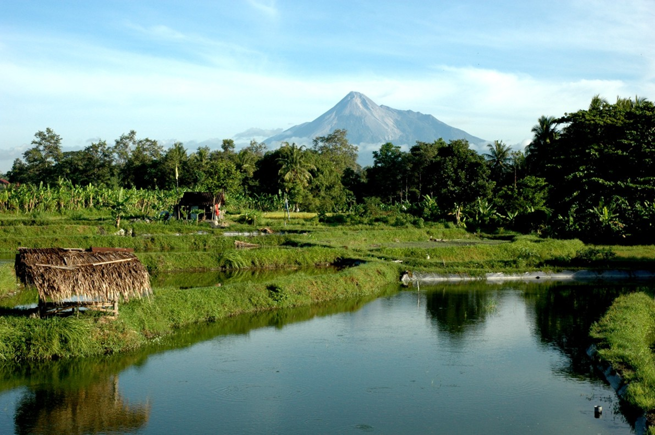
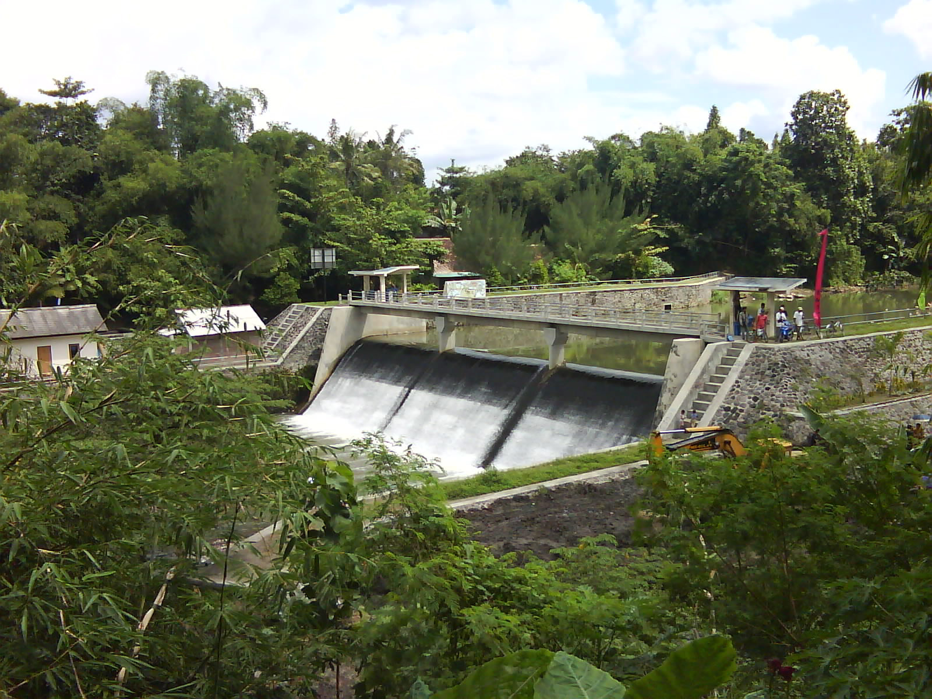
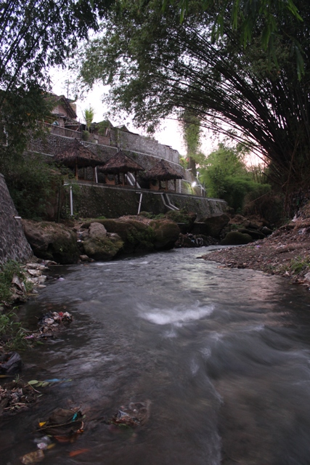
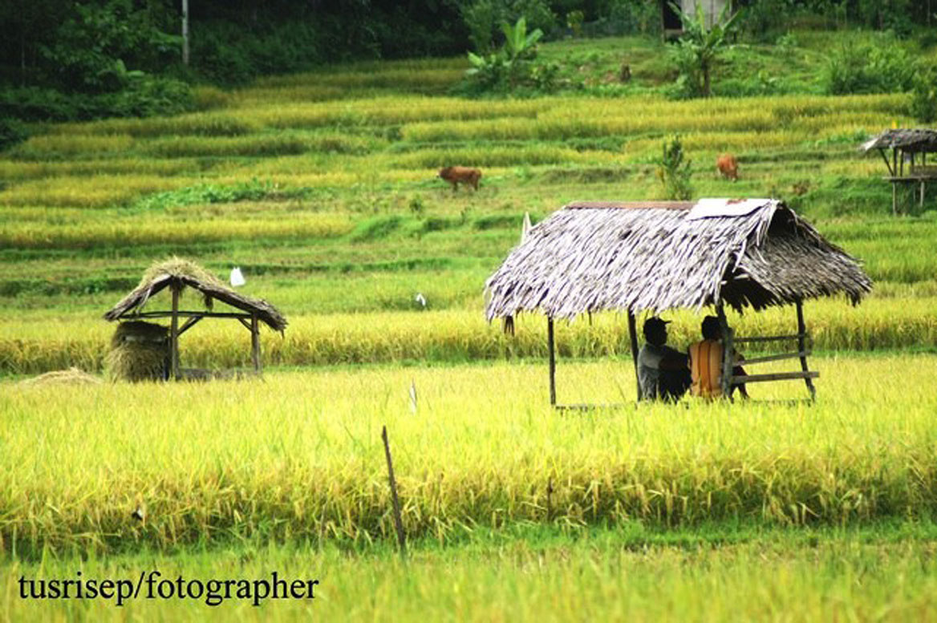
Gajah Wong River Is Unique
The source of the river water is from springs
Good quality springs
Springs have heritage value
Gajah Wong River Watering 40.000 Ha ricefields in Bantul Regency (south of Yogyakarta city)

Slide 4
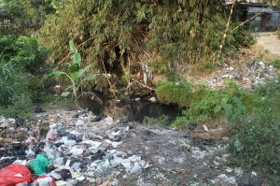
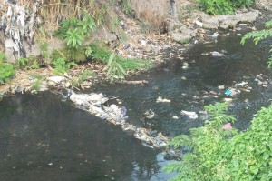
But Gajah Wong River catagorized in the most dirty and polluted river in Yogyakarta (BLH DIY,2012)

Slide 5
Un Integrated tourist spots along Gajah Wong Riverside area from the north to the south
Affandi Art Gallery
Gembira Loka Zoo
Umbul Raja
Umbul Naga
Umbul Lanang
Umbul Wadon
Gajah Wong Educational Park
Old Mataram’s king cemetery
Umbul Kemuning
Sendang Selirang
Cinde Amoh
Dam
Giwang culture Center Village
Very Old Beringin (Banyan) tree planted by Sunan Kalijaga
Map of Greater Yogyakarta

Slide 6
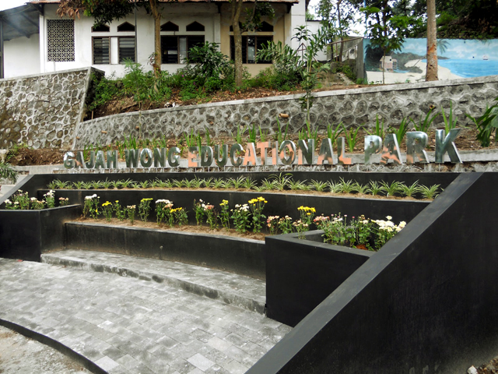
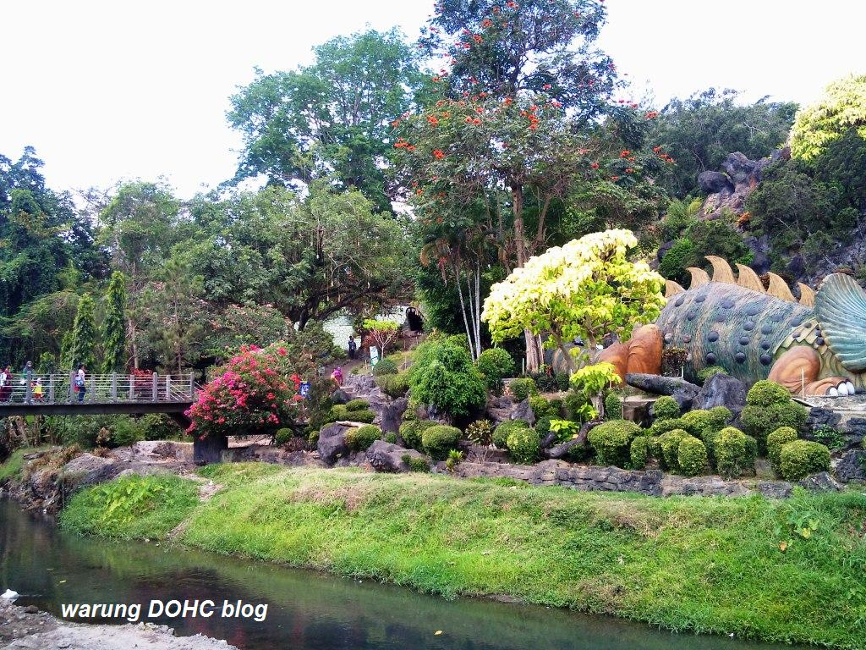
Towards Yogyakarta Green City
There are eight indicators of Green City:
Green Planning and Design
Green Open Space
Green Community
Green Waste
Green Transportations
Green Water
Green Energy
Green Building

Slide 7
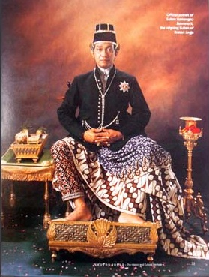
Developing integrated Eco-Tourism in Gajahwong riverside area supports Sustainable Development and accelerating the National Resilience
Guidance by the spirit of “Hamemayu Hayuning Bawono” and conducts in the spirit of “Segoro Amarta”

Slide 8
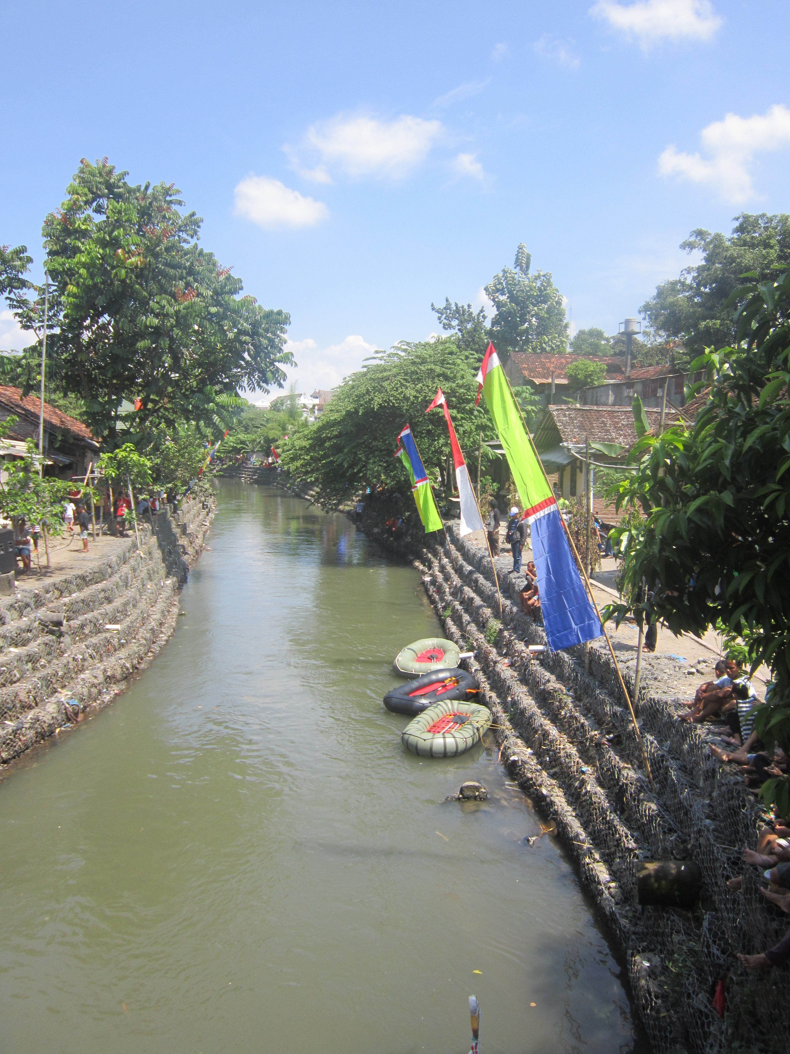
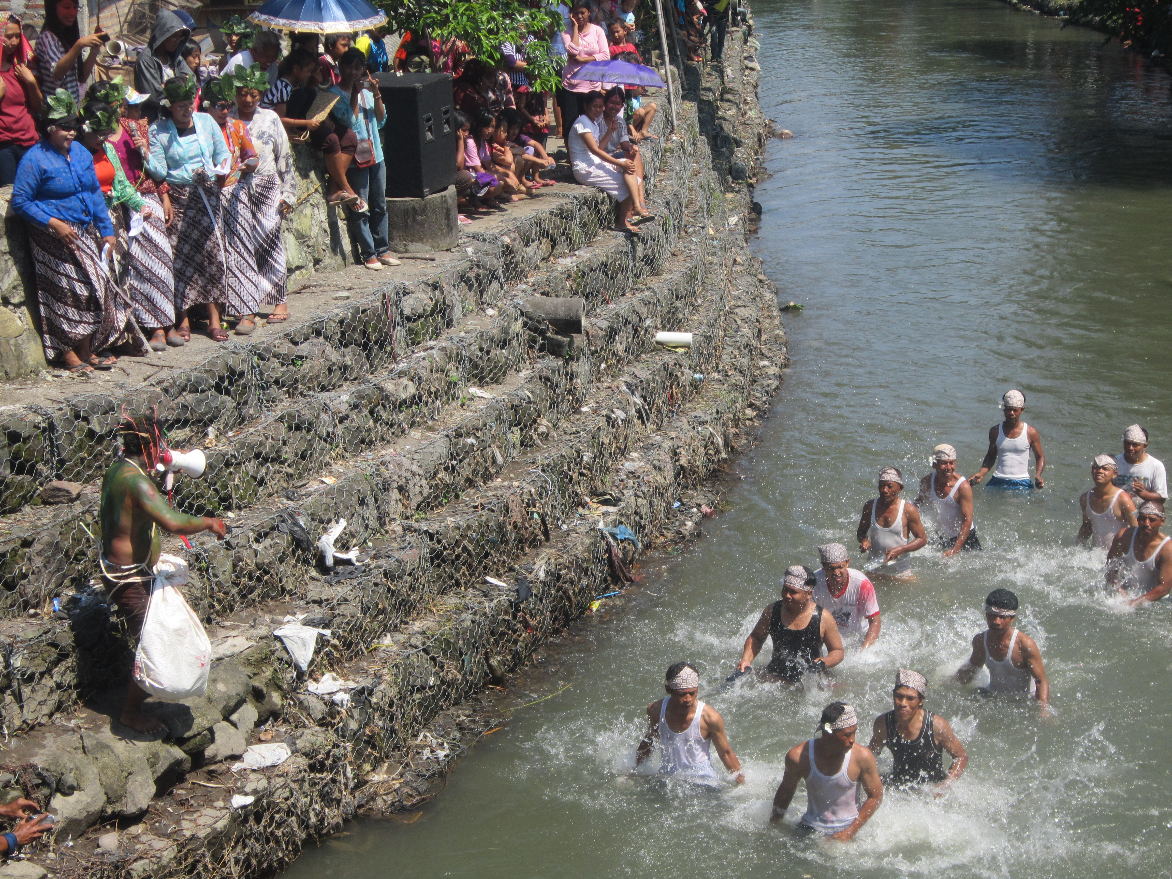
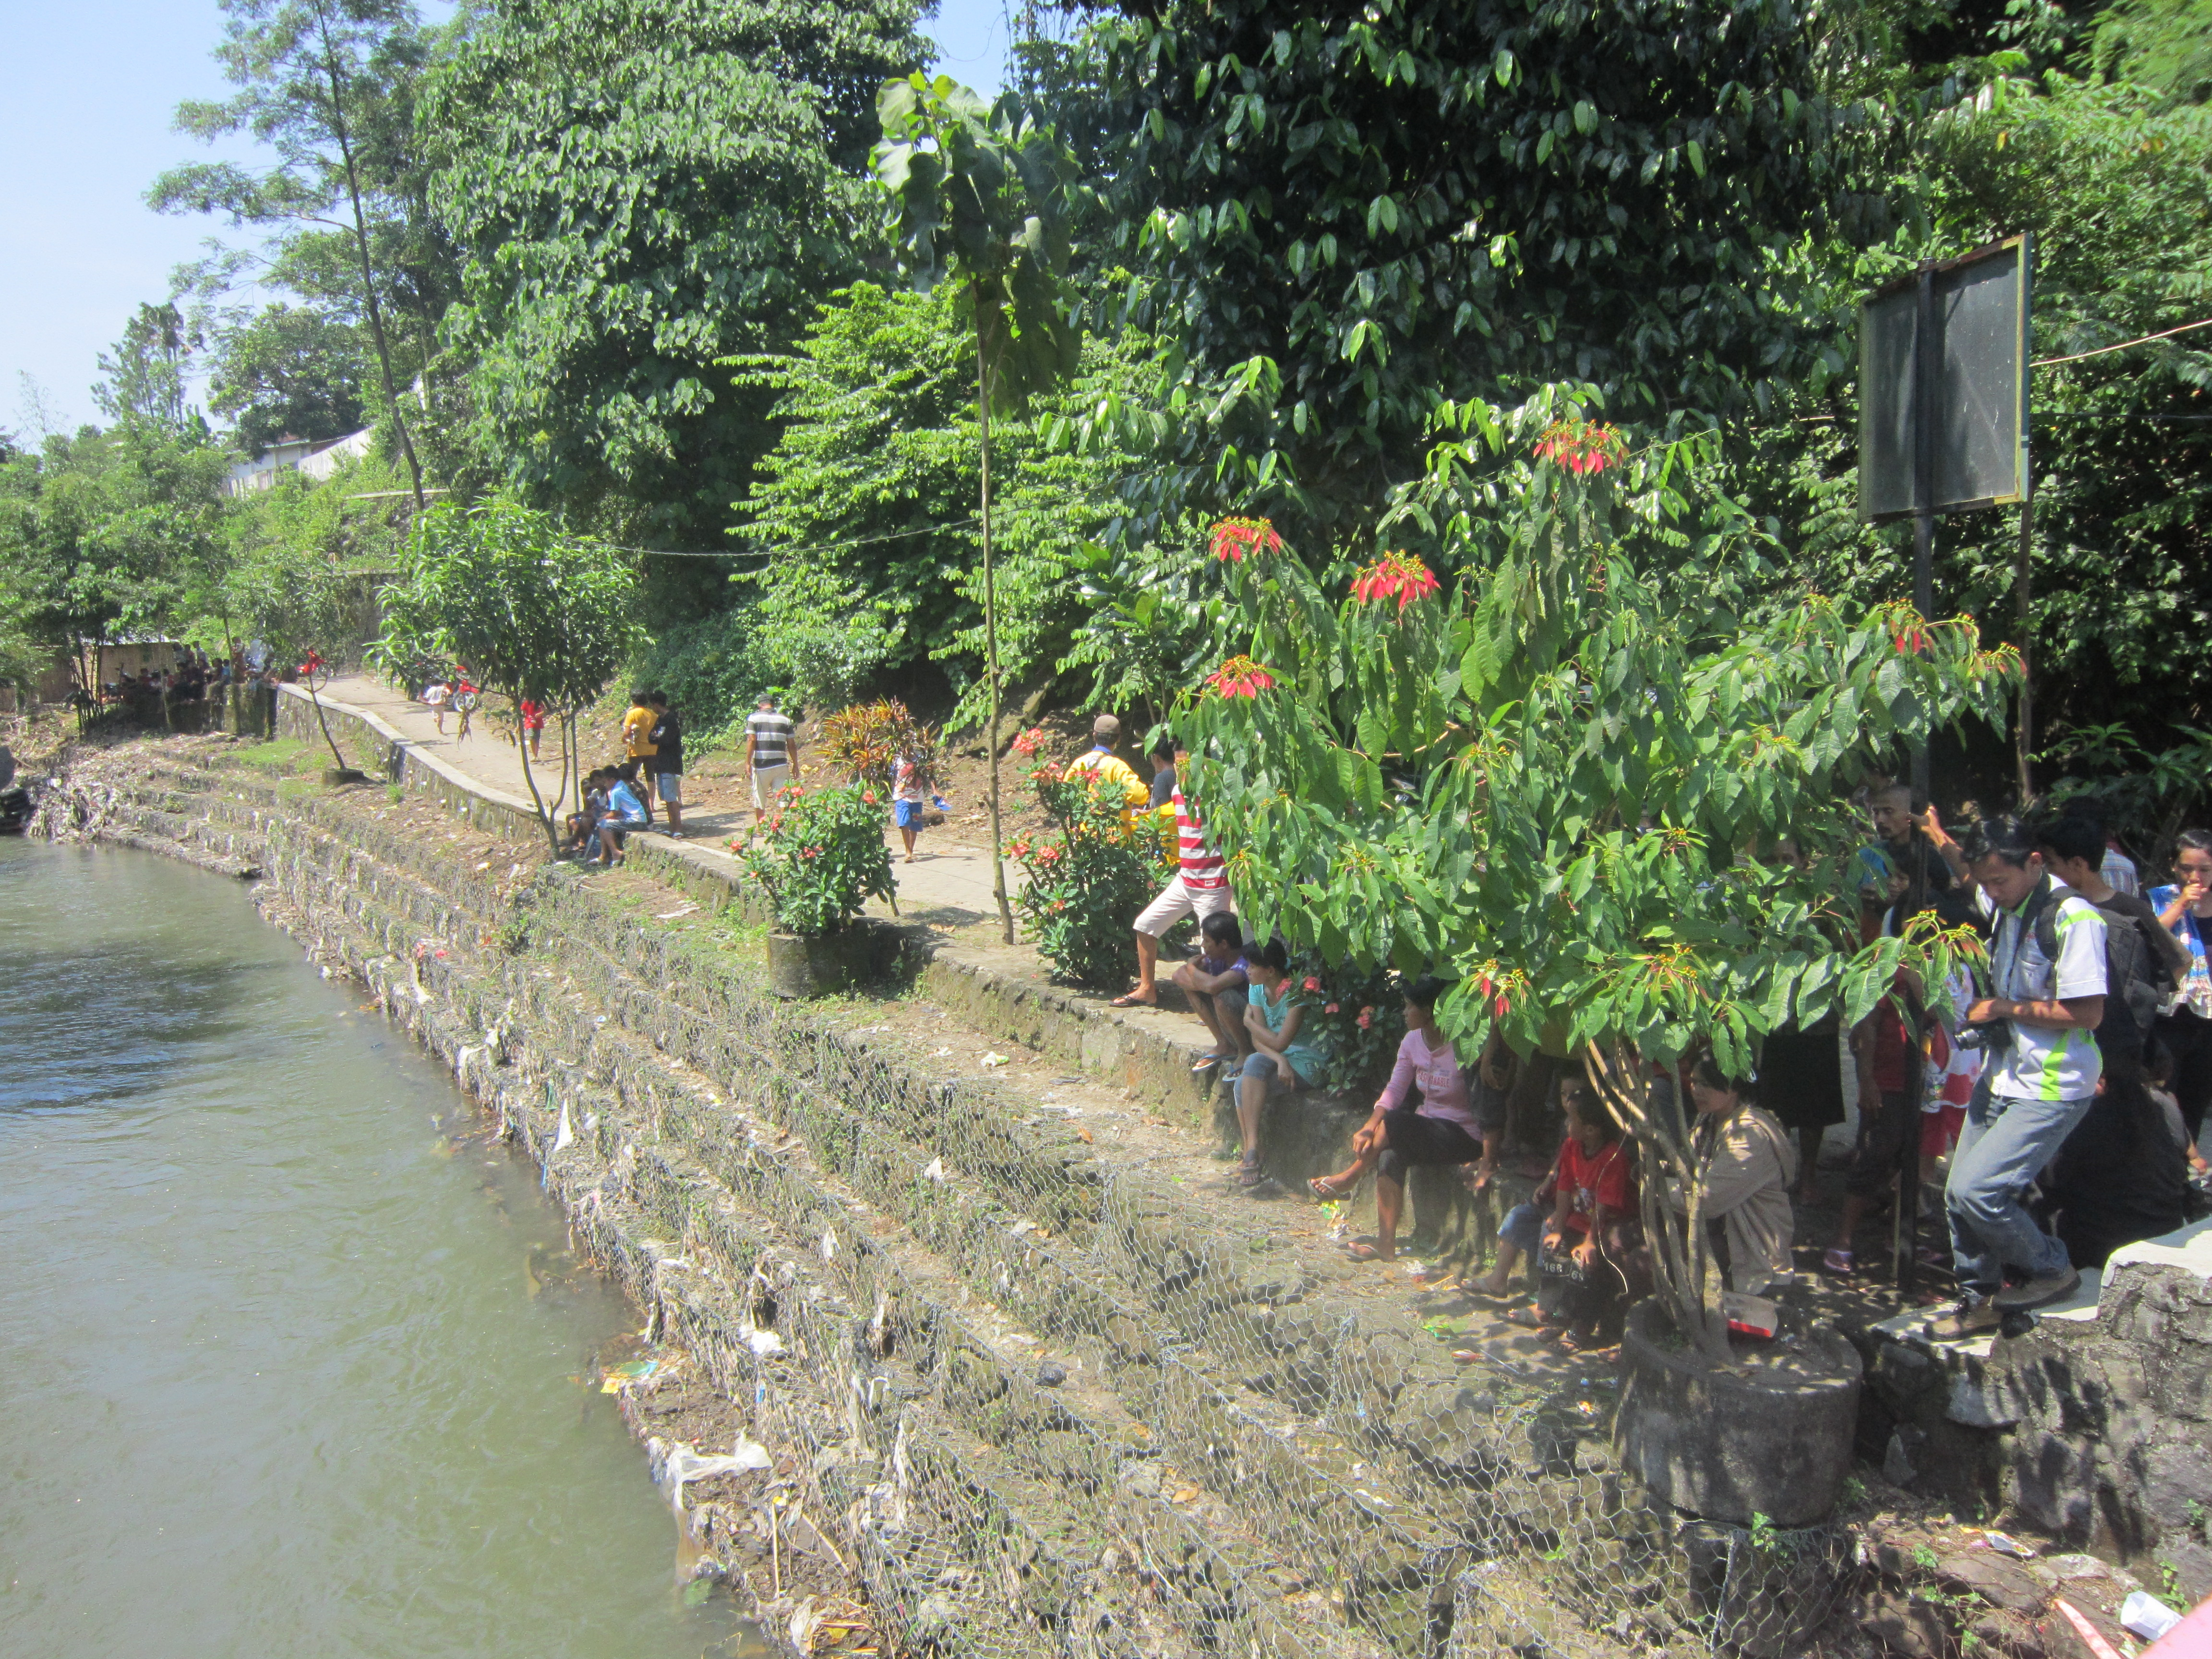
AIMS
To analyze the Strenghts, Weaknesses, Opportunities and Threats in developing integrated Eco-Tourism in Gajah Wong riverside area to find the strategic solutions for sustainable development achievement and the strength of National Resilience

Slide 9
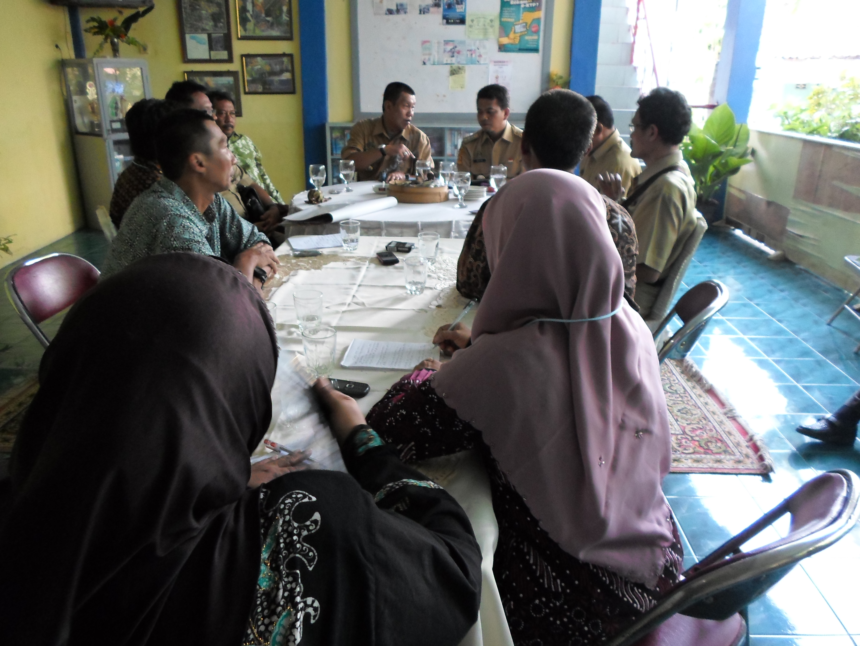
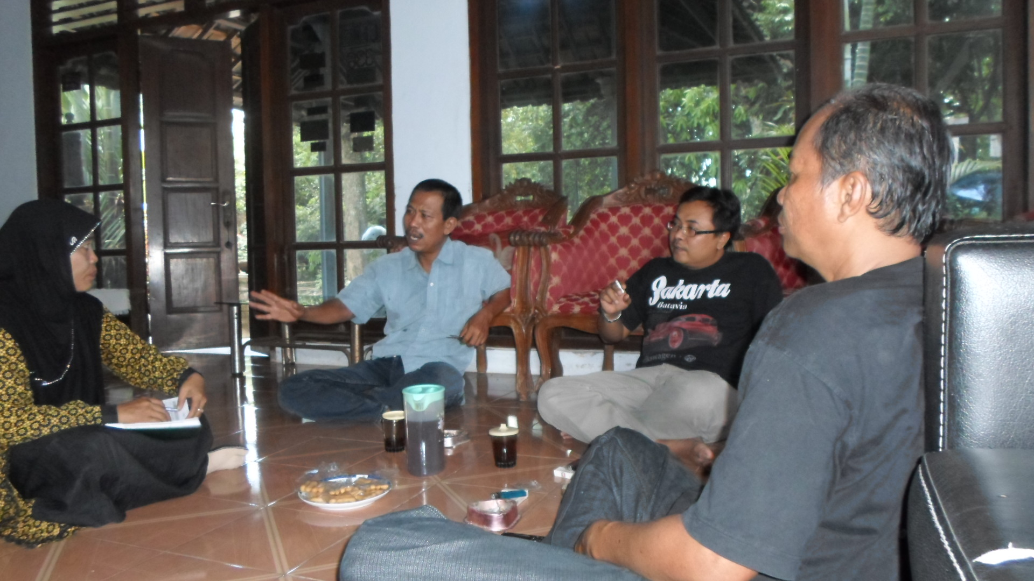
METHODS
This research conducted as field research
“Field research is any activities aimed at collecting primary/original or otherwise unavailable data, using methods such as face to face interviewing, telephone and postal surveys and direct observation”
(www.Businessdictionary.com/definition/field-research.html)
The respondents are key person (informan), they are: related govermental institutions (BBWSO, BLH DIY, BP DAS DIY, Dinas Kebudayaan, Dinas Pariwisata), Camat, Kepala Desa, Ulu-ulu, RW, Forsidas Gajah Wong and groups of hobbies and economic activities community in the area of study
The data collected by direct observation, Focus Group Discussion, in-depth interview and documentation

Slide 10
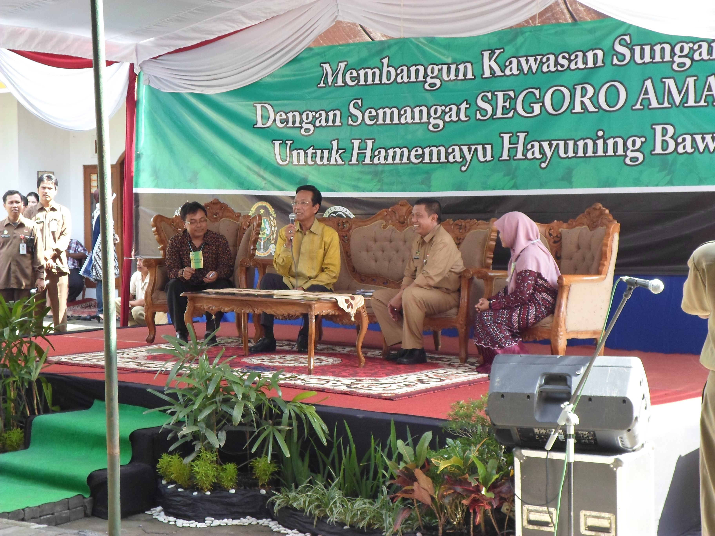
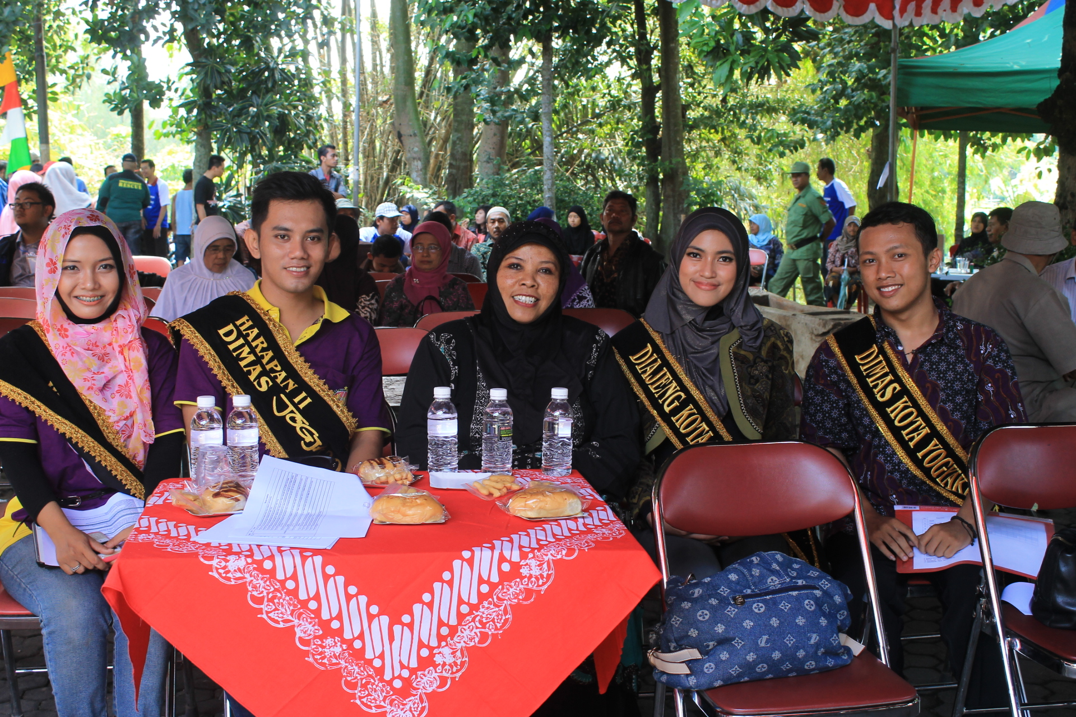
RESULTS AND DICUSSION
STRENGTH
Source of the river water is from 24 natural springs along the body of Gajah Wong river.
some springs have heritage value and legally protected.
the big quantity of river water had been watering 40.000 ha ricefields in Bantul regency (South of the Yogyakarta City)
Yogyakarta Green Open space 32,45 % of the city lands (above the minimum standart 30%)
many tourist spots surrounding Gajah Wong river

Slide 11
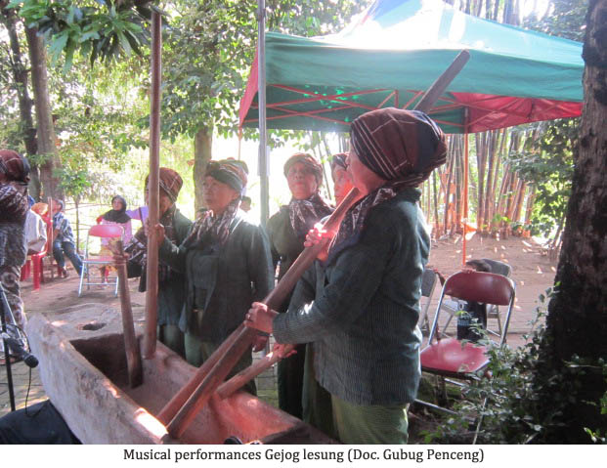
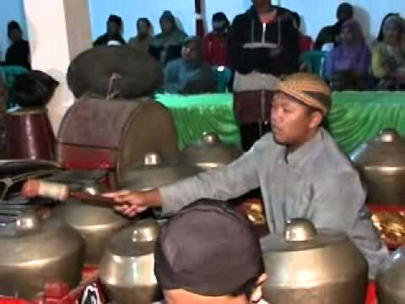
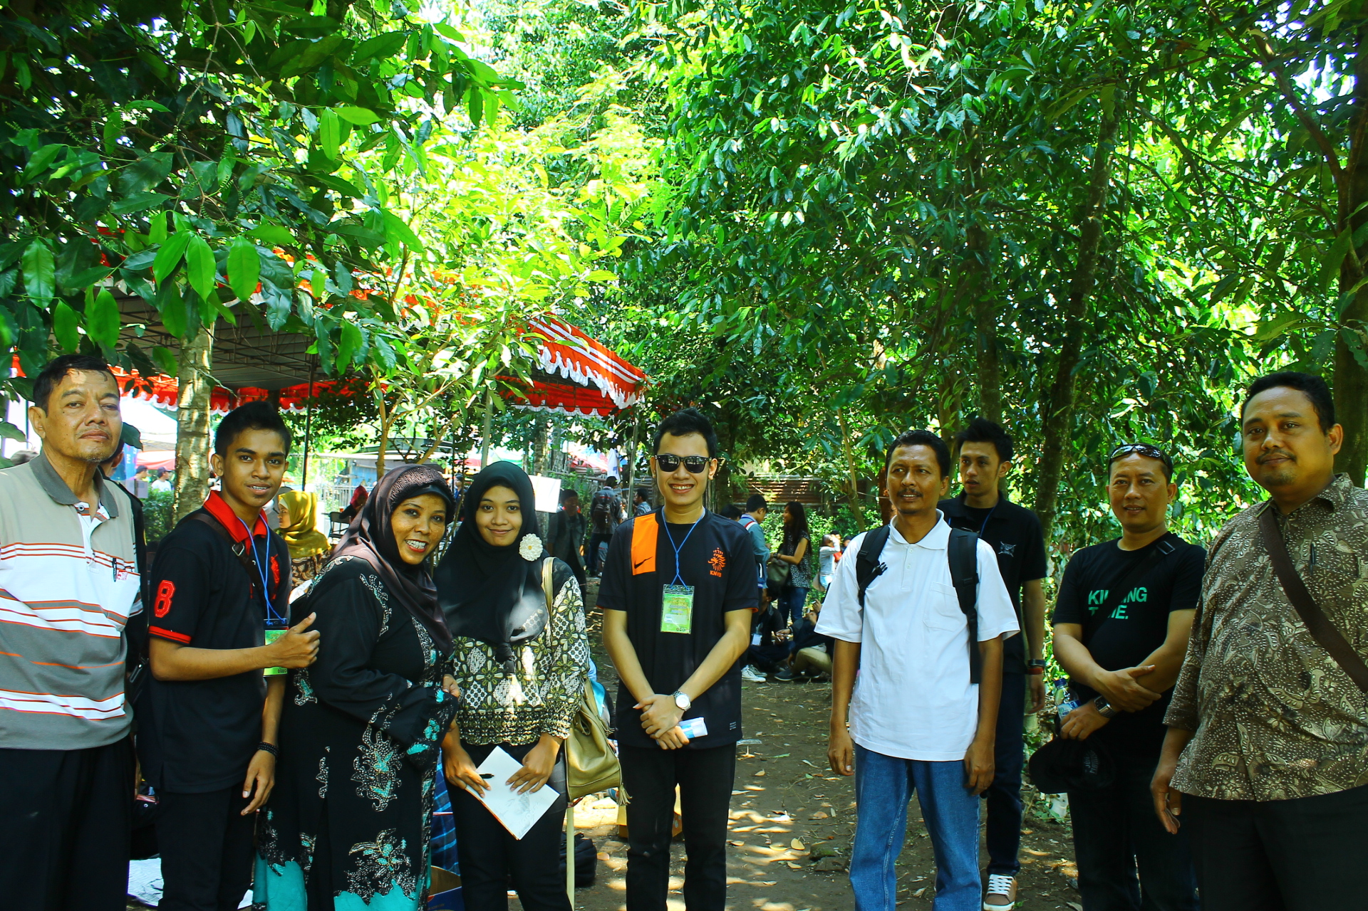
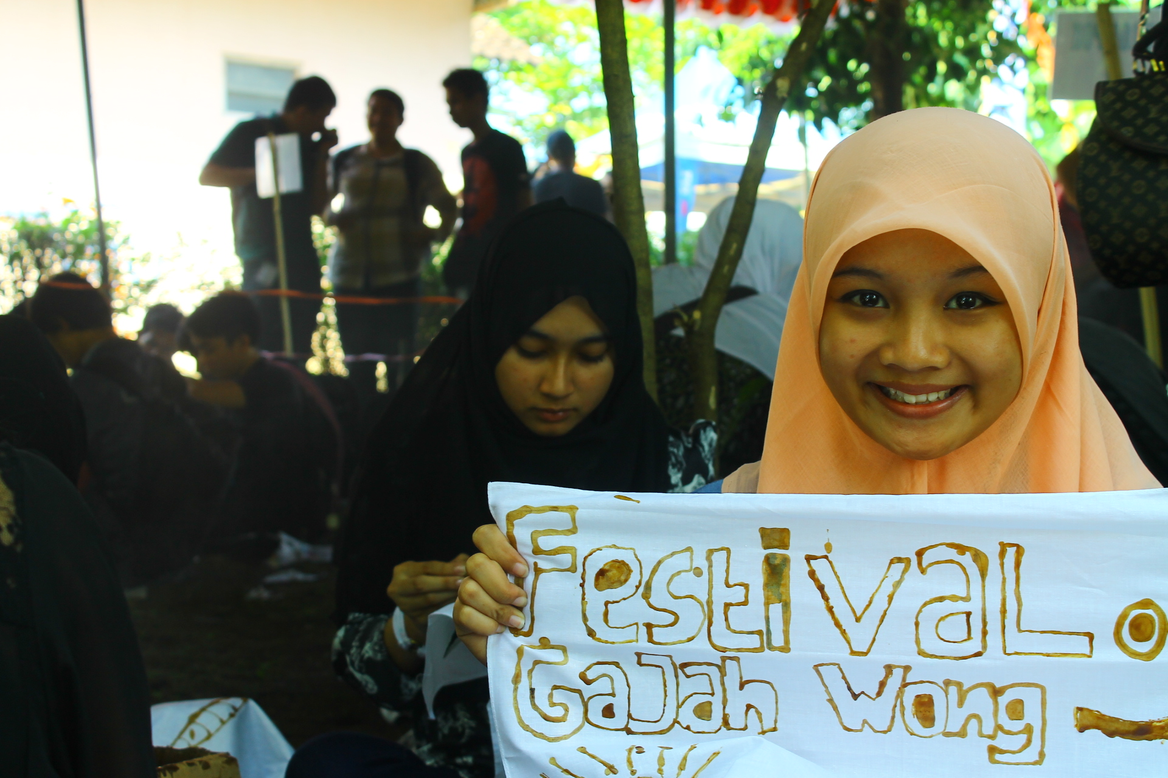
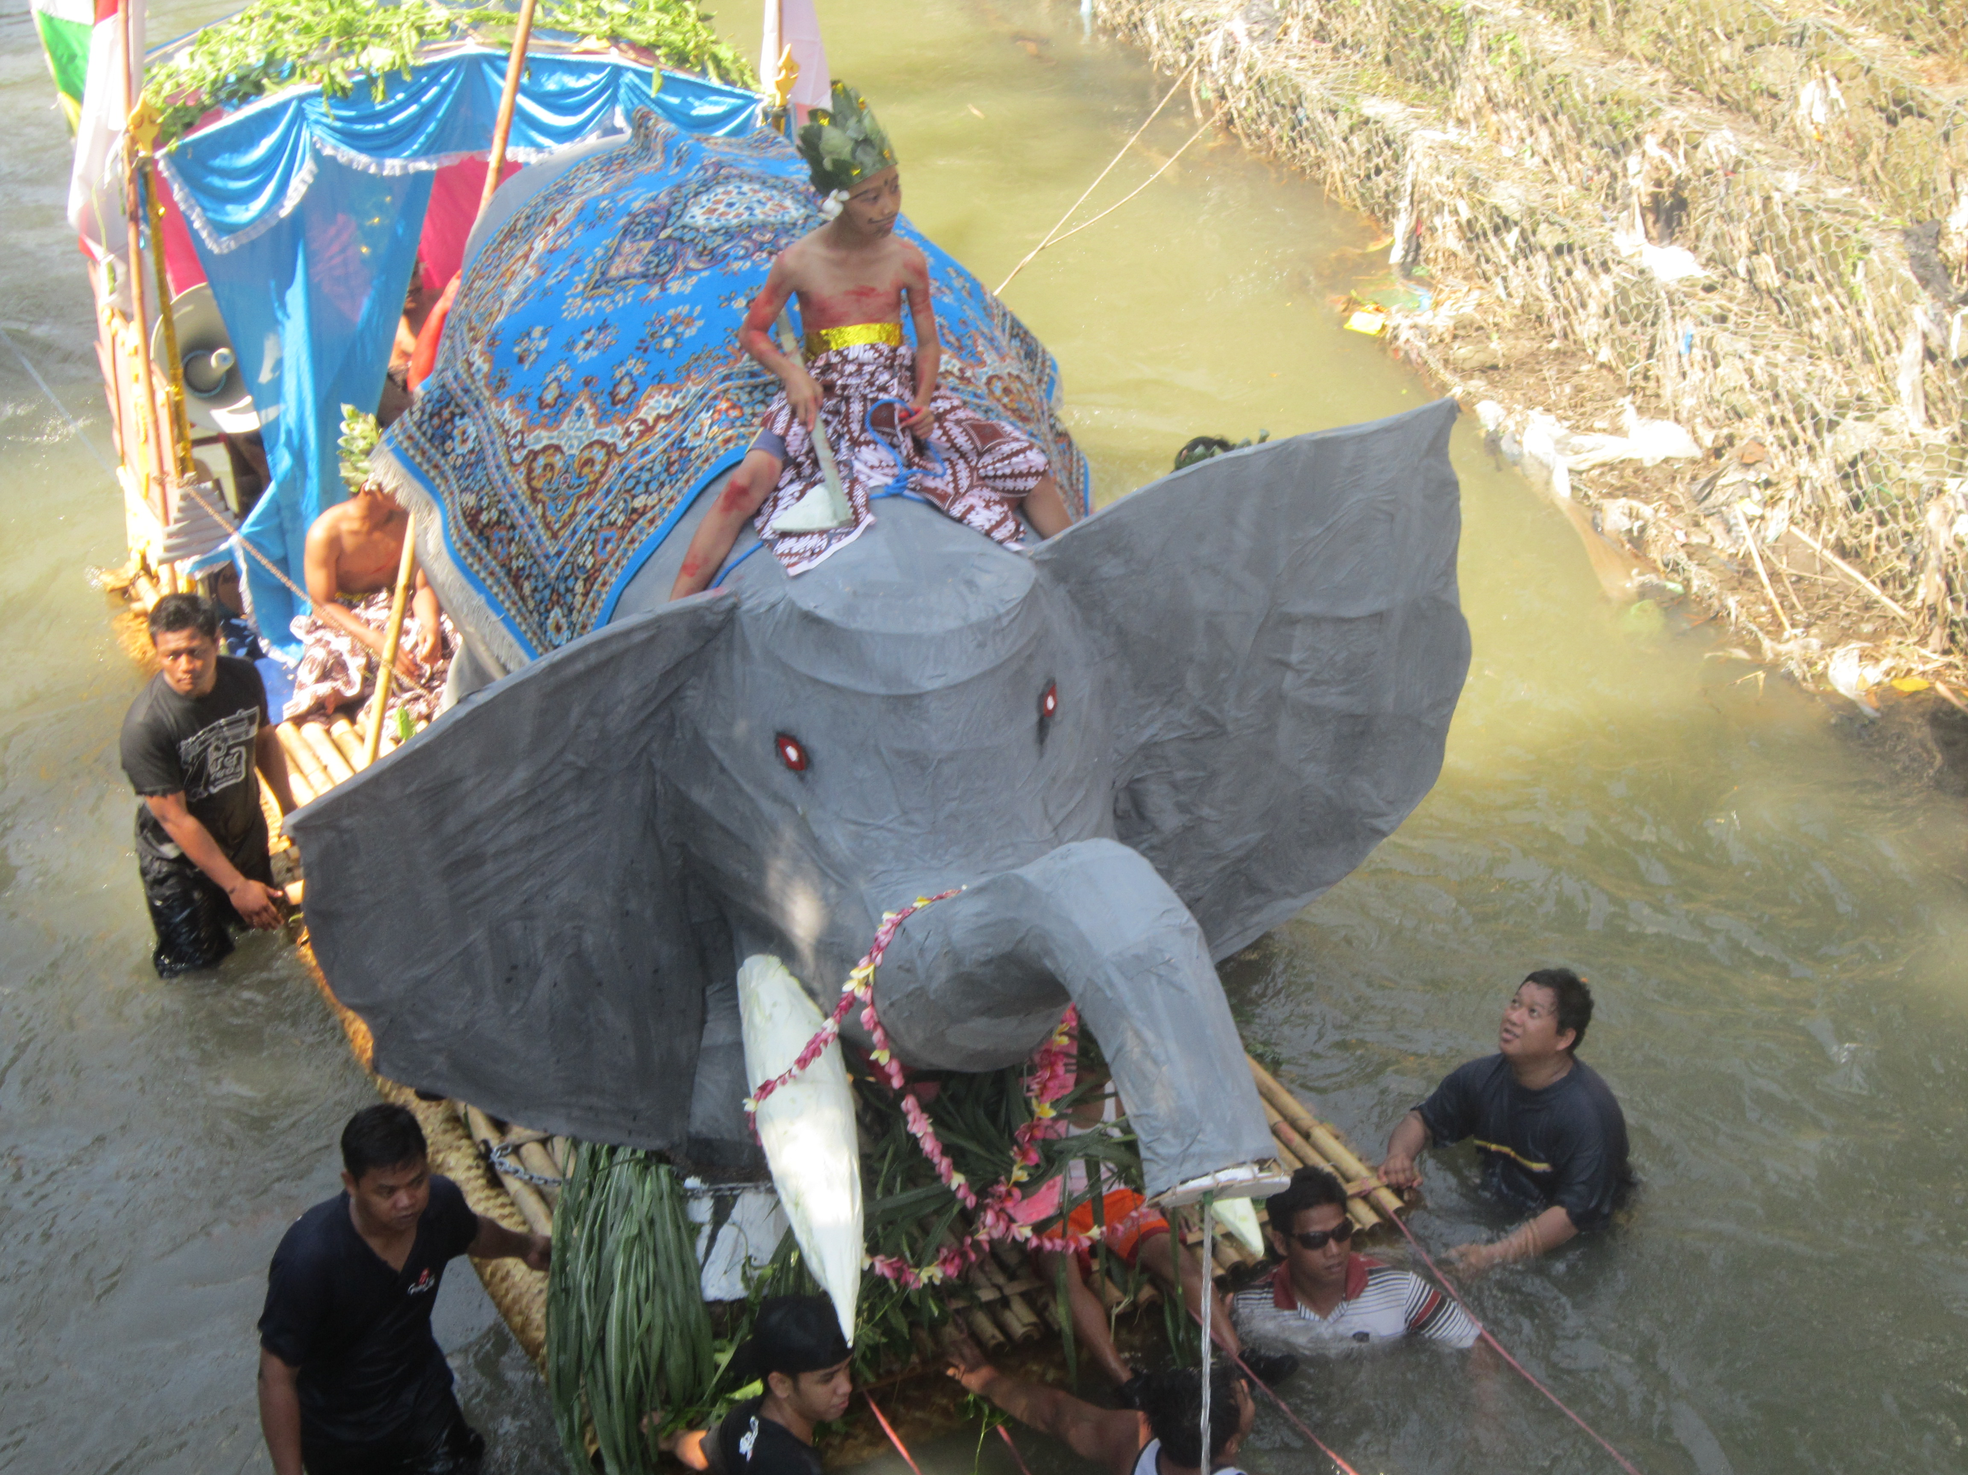
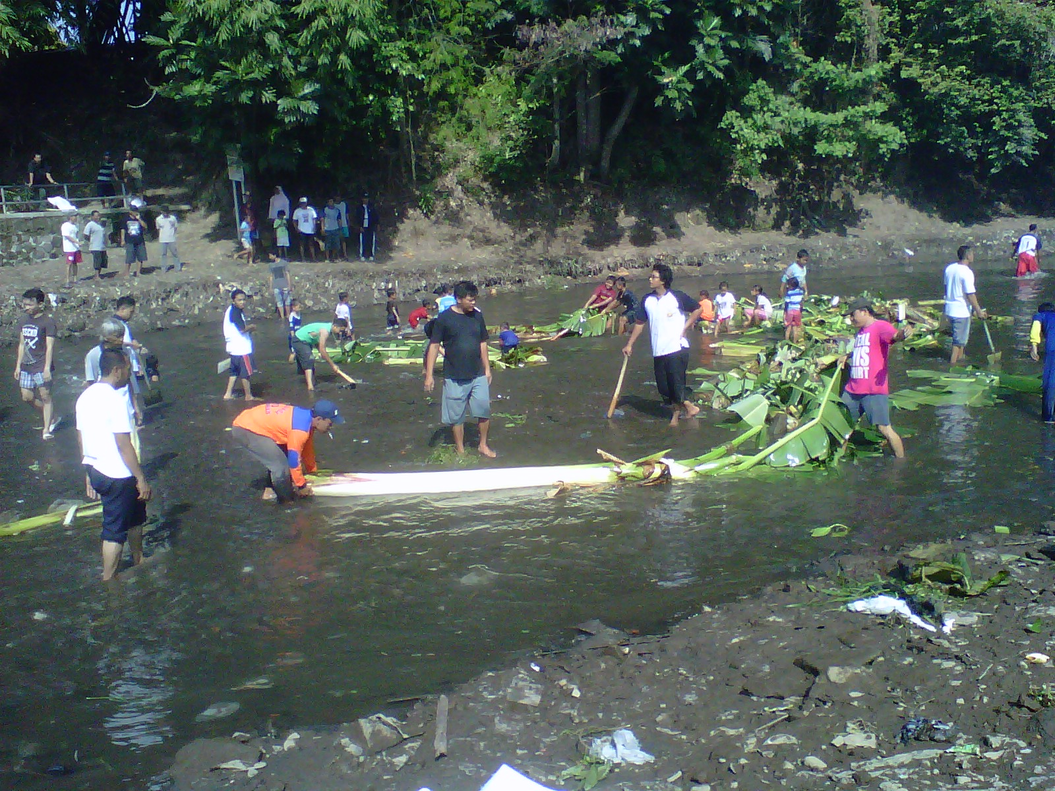
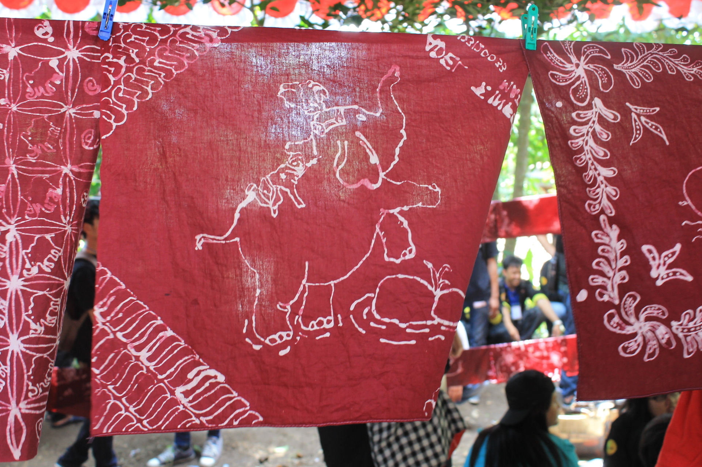
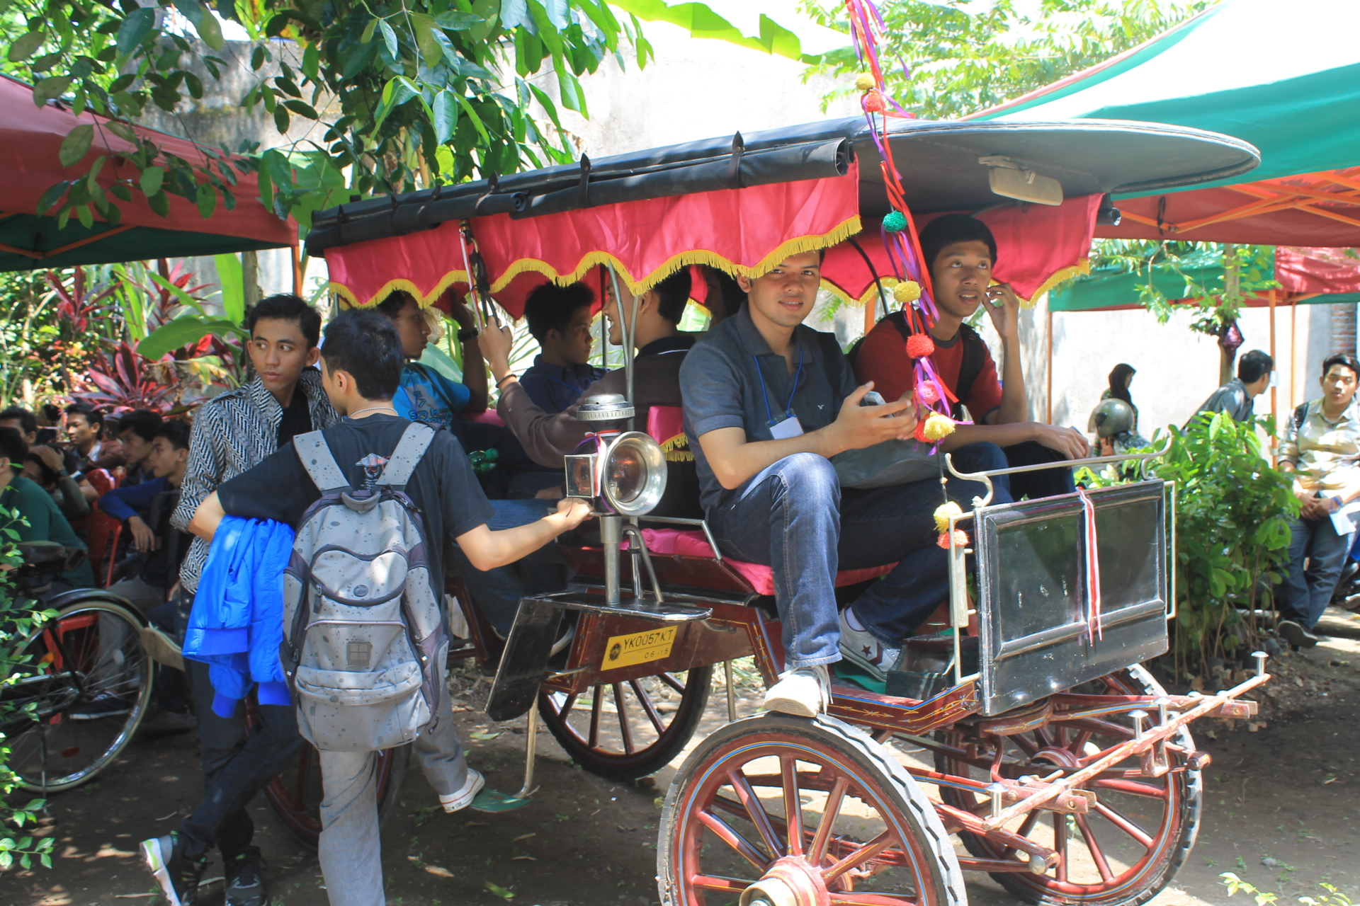
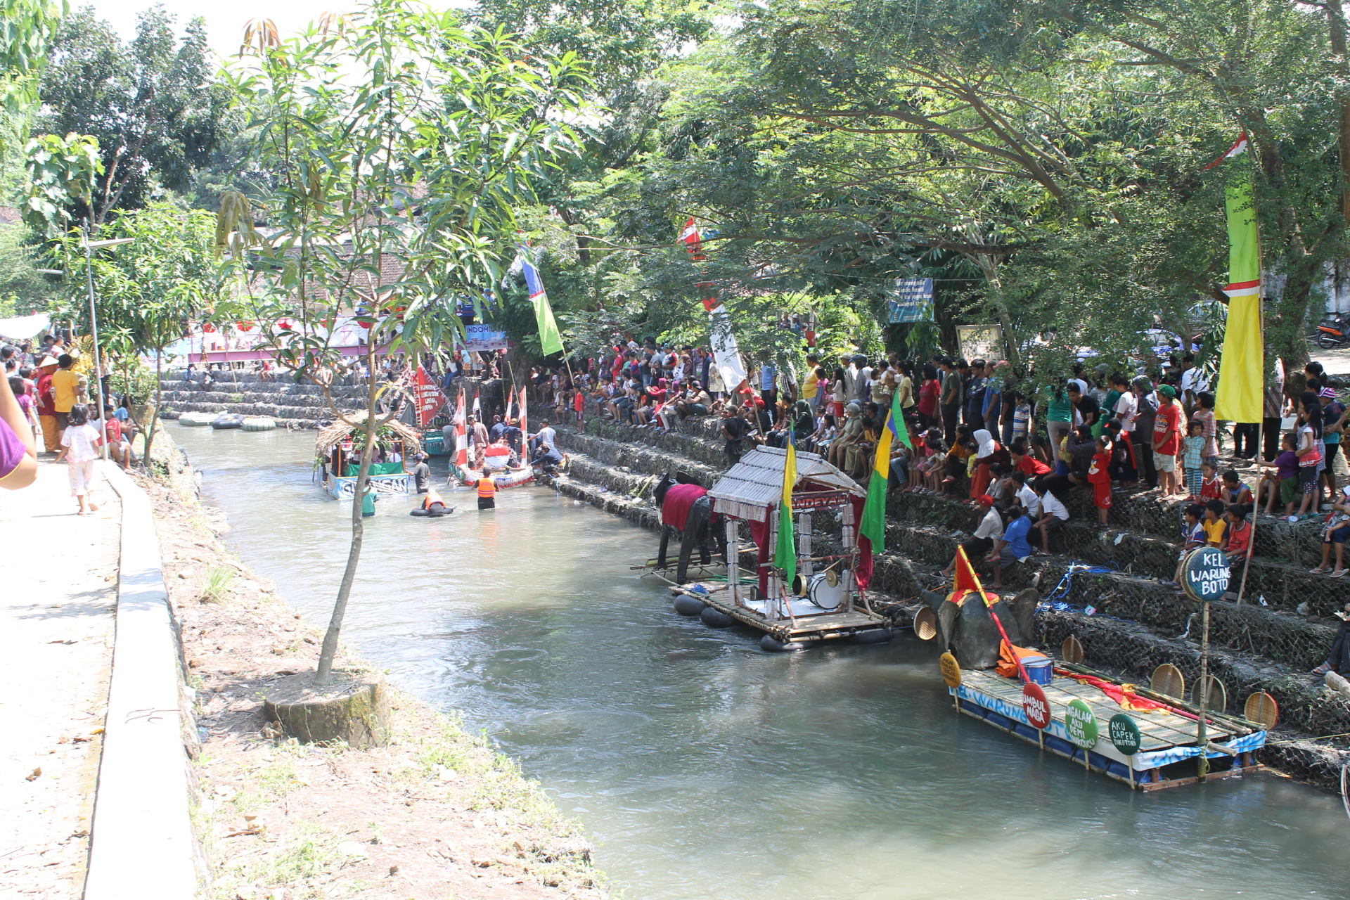
Gajah Wong riverside area is strategic location in the city
The enterpreuneurship of the local people
Many groups of hobbies, artist of arts and culture performance
The commitment of local community to participate in development

Slide 12
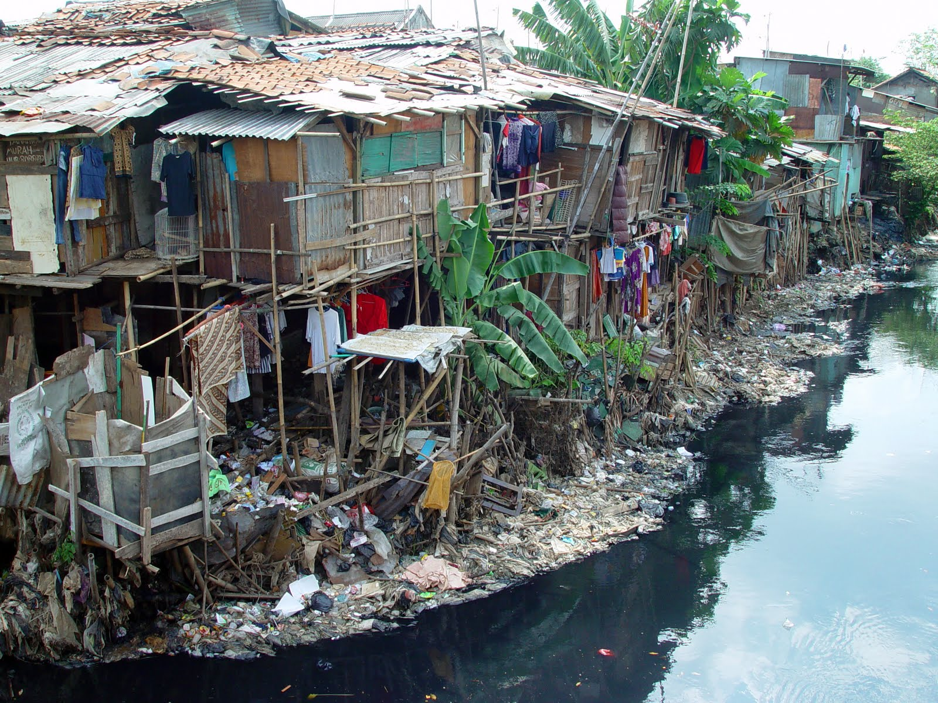
WEAKNESSES
The dirtiest river water
Poor heritage springs
No green knowledge
Low managerial skill
Poverty
Less capital/investment
Minime infrastructure
Illegal housing in the river line
Regulation and law enforcement

Slide 13
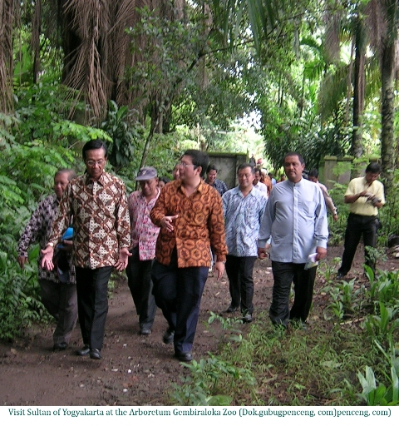
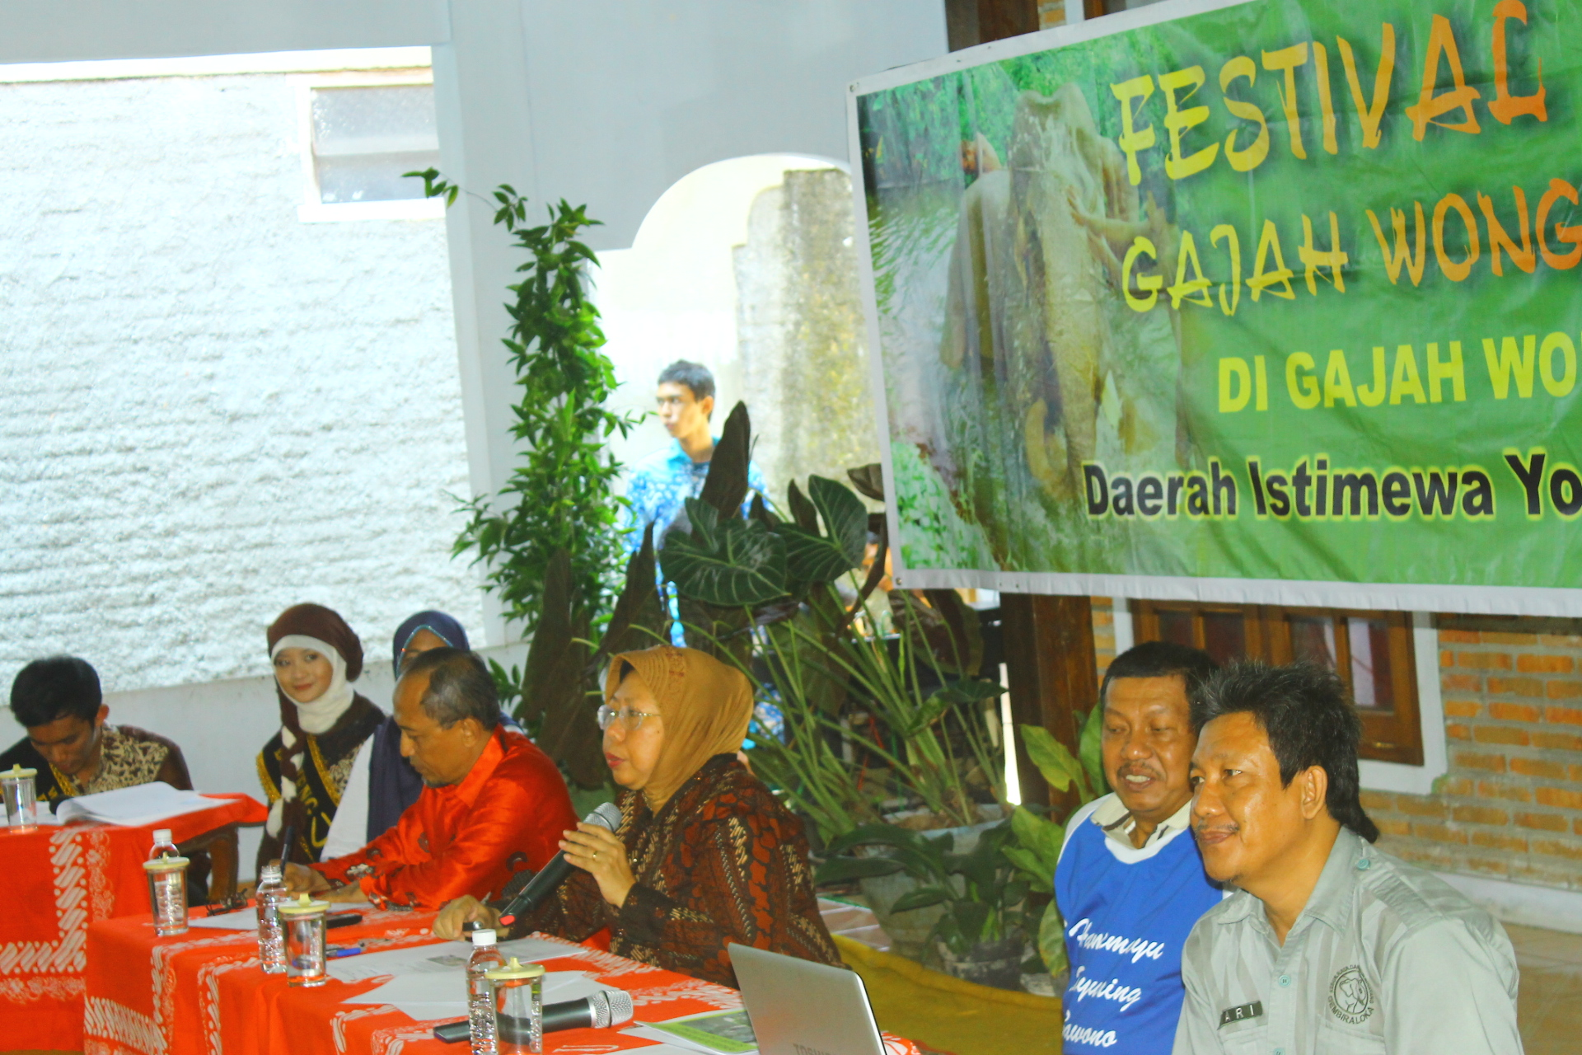
OPPORTUNITIES
Goverments supports (regulations and institution)
Academicians supports (UPN “Veteran” Yogyakarta, Gajah Mada University, Indonesia Arts institute etc)
Groups of hobbies and economic activities in the area of study
River community forums (Forsidas Gajah Wong)
Legally protected situs and heritage
Yogyakarta towards green city
Strengthen the identity of “Yogyakarta Istimewa”

Slide 14
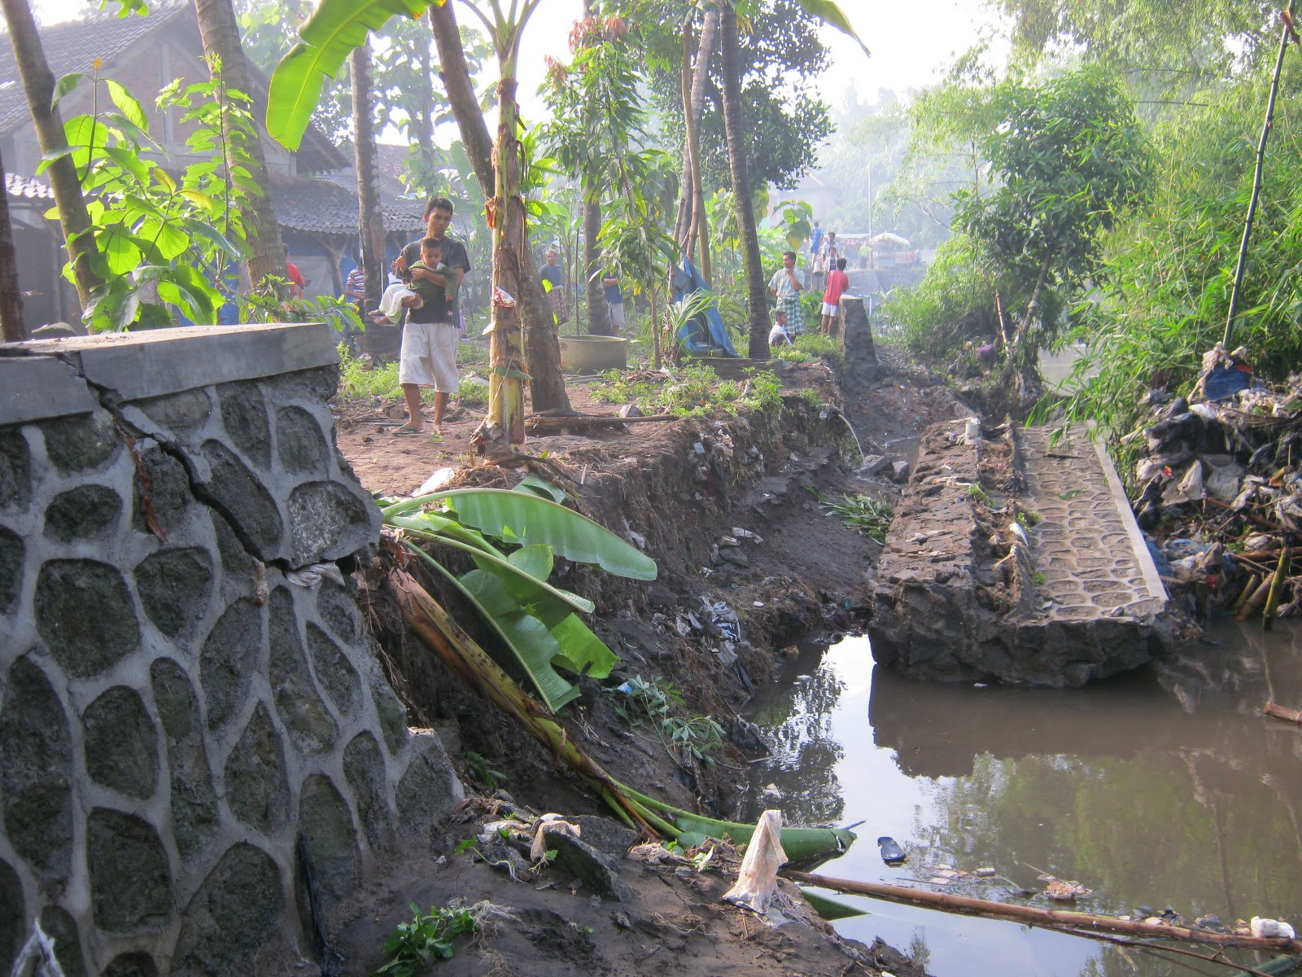
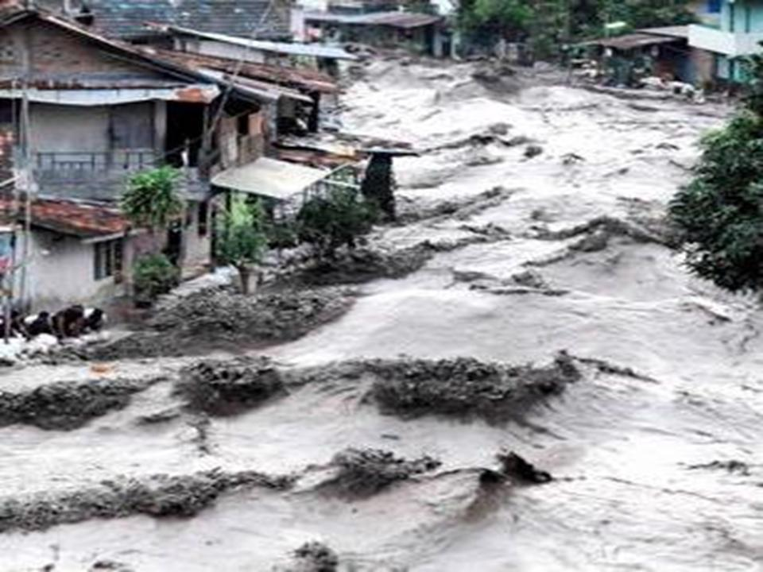
THREATS
Dissaster (Merapi Volcano’s lahar, floads, erruption, land slide, earth quacke, twister)
Global warming
Situs and heritage destructions
Uncontrol population growth
Travel warning
Terorism
Corruption

Slide 15
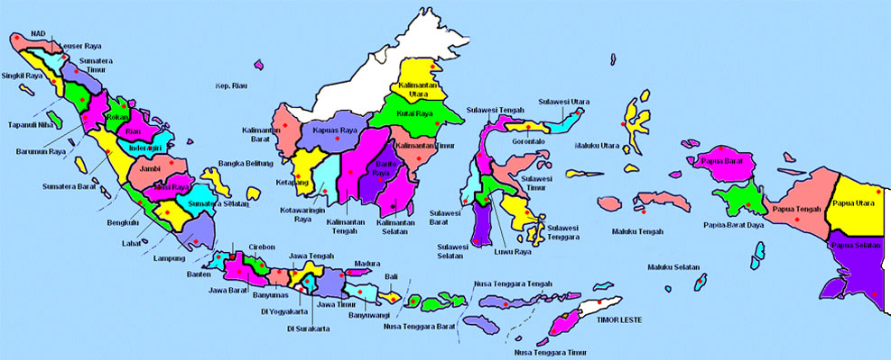
NATIONAL RESILIENCE
National Resilience is National dynamic conditions contains strengths and perseverances in facing challenges, threats, barriers and inferences which are threaten national identity, integrity and existency.
(Lemhannas RI, 1999)
There are 8 elements/potencies of National Resilience:
Location/position of the country
Natural Resources
Human Resources
Ideology
Politics
Economics
Social and Culture
Defense and Security

Slide 16
NATIONAL RESILIENCE PRINCIPLES IN THE CASE OF STUDY
Natural resources (land,water and natural wealth contained it) well manages in suistainability and utilized largely for the peoples necessity)
Well educated local people (also in green knowledge)
The implementation of national way of life (ideology) pancasila in all aspects of development
Good governance and clean goverment
Grass root democracy
Green business/green economic activities
The sustainability of social and culture of local community
Regulation and law enforcement
The national security protections

Slide 17
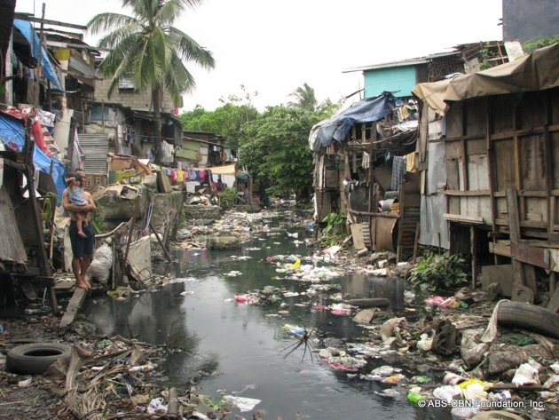
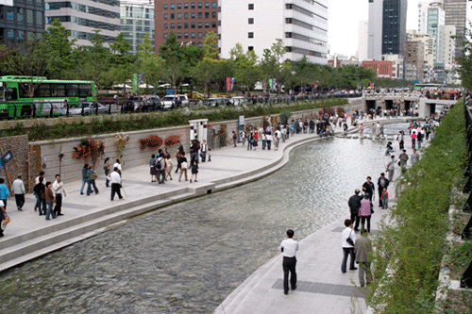
CONCLUSION
Yogyakarta as tourist city, developing Community Based Tourism concept which is offers the environmental resources and local way of life. “Hamemayu Hayuning Bawono” and SEGORO AMARTA guidance Yogyakarta towards Green city.
By developing Gajahwong river and the situs and heritage surrounded, people can earn from it for living. Integrated eco-tourism along the Gajahwong river in Yogyakarta city will push the economic growth and other social aspects. The sustainable development will occur and the national resilience will getting stronger.

Slide 18
RECOMMENDATION
The recommendation of this research is that the synergy of five pillars namely Local Community, Local Government, Academicians, Investor and National Policy is really needed.
Local community alongs the Gajah Wong river must be eager to develop self resilience and participate in involvement with social and cultural or economic creative groups and maintenance the environment in the same time for sustainable development.
Local government should strengthening community and business leadership role in developing arts and culture and regulate people activities to maintenance the heritage.
Academician should participate more in finding the way out solving the problem that may appears with their capability in science and technology.
Investor (Government and Private investor) should keep on support the finance for arts, culture, creativity and design communities which is could be support by ventura capital, donator, sponsor, syariah bank and rolling funds from government
National Policy should be applicable and accelerate the synergy of the local community and the local government in developing integrated eco-tourism at the Gajah Wong riverside area.

Slide 19
ACKNOWLEDGEMENT
I would like to thanks to the organizing committee of the ICGAI for inviting and providing me this opportunity to present this paper in planary session. And also I would like to thanks to all my friends in FORSIDAS Gajahwong and the committee of Gajahwong Festival 2013 for the support and good friendship.

Slide 20
REFERENCE
Carson, Rachel, Silent Spring, Houghton Miffin, 1962
Dobson, Andrew, “Green Political Thought”, http://www.thehealingproject.netau/wp=content/uploads/2009/ANDREW-DOBSON-Green-Political-Thought.pdf, download, January 2012
Government’s Regulation: UU No. 7 Th 2004 tentang Sumber Daya Air
Government’s Regulation: UU No. 26 Th 2007 tentang Penataan Ruang
Government’s Regulation: UU No. 32 Th 2009 tentang Perlindungan dan Pengelolaan Lingkungan Hidup
Government’s Regulation: UU No. 1 Th 2011 tentang Perumahan dan Kawasan Permukiman
Government’s Regulation: PP No. 38 Th 2011 tentang Sungai
Government’s Regulation: UU No. 13 Th 2012 tentang Keistimewaan DIY – Rancangan Perdais Pemda DIY tentang Tata Ruang
Fandeli, Chafid, Mukhlison, “Pengusahaan Ekowisata”, 2000
Kimpraswil Yogyakarta, 2010
Lemhannas RI, Ketahanan Nasional,1999
Payne, Dinah, M and Cecily A. Raiborn, “Sustainable Development: The ethics support the Economics”, Journal of Business Ethics, 2001
Syamsiarini, Rani, 2013, Dinas PUP-ESDM DIY, “Peran Pemerintah Dalam Pembangunan Kawasan Sungai Gajahwong”, Seminar Nasional Lingkungan Hidup, Yogyakarta, 21 April 2013, unpublish
The Document of RPJPD Kota Yogyakarta 2005-2025
The Ministery of Tourism’s Report, 2010
Winarso, Setyo, 2013, Pengembangan Kawasan sebagai pendukung Kawasan Pemukiman yang berkelanjutan, Pusat Pengelolaan Ecoregion Jawa, Kementerian Lingkungan Hidup, Seminar Nasional, unpublish
www. Businessdictionary.com/definition/field-research.html
Yin, Robert K. 1989, Case Study, Design and Methods. Sage Publication. New Delhi.

Slide 21
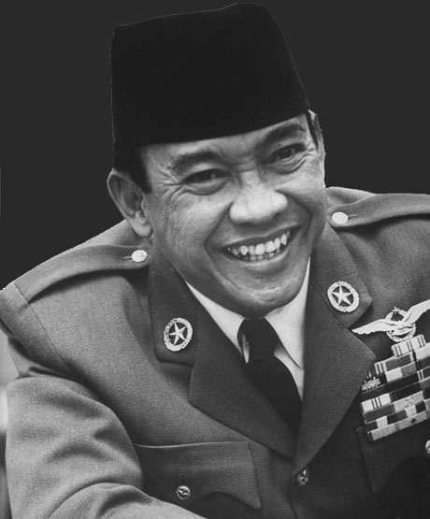
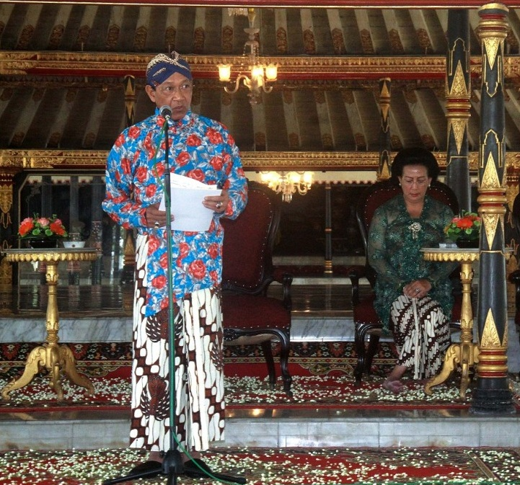
THANK YOU
TERIMA KASIH
MATUR NUWUN

